Slide 1


PIZZA SALES
ANALYSIS

Slide 2
EXCEL FILES FOR ANALYSING DATA USING SQL
Order_details
Orders
Pizza Types
Pizzas

Slide 3
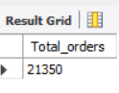
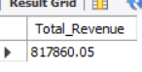
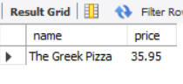
SQL QUERIES USED IN PROJECT PIZZA SALES DASHBOARD
Retrieve the total number of orders placed
Select count(*) as Total_orders from orders;
Calculate the total revenue generated from pizza sales.
Select round(sum(pizzas.price * order_details.quantity),2) as Total_Revenue from pizzas
join order_details on pizzas.pizza_id = order_details.pizza_id;
Identify the highest-priced pizza.
select pizza_types.name,pizzas.price from pizza_types join
pizzas on pizza_types.pizza_type_id = pizzas.pizza_type_id order by price desc limit 1;

Slide 4
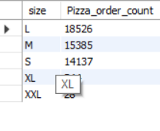
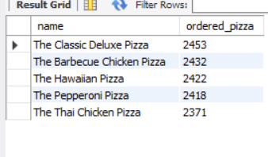
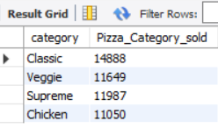
-- Identify the most common pizza size ordered.
Select pizzas.size,count(order_details.Order_details_id) as Pizza_order_count from pizzas
join order_details on pizzas.pizza_id = order_details.pizza_id
group by pizzas.size order by Pizza_order_count desc;
-- List the top 5 most ordered pizza types along with their quantities.
Select pizza_types.name,sum(order_details.quantity) as ordered_pizza from pizza_types
join pizzas on pizza_types.pizza_type_id = pizzas.pizza_type_id join
order_details on order_details.pizza_id = pizzas.pizza_id group by name order by ordered_pizza
desc limit 5;
Join the necessary tables to find the total quantity of each pizza category ordered
Select pizza_types.category,sum(order_details.quantity) as Pizza_Category_sold from
pizza_types join pizzas on pizza_types.pizza_type_id = pizzas.pizza_type_id
join order_details on pizzas.pizza_id = order_details.pizza_id group by category;

Slide 5
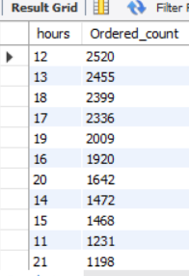
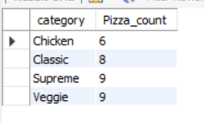
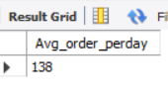
Determine the highest distribution of orders by hour of the day.
Select hour(order_time) as hours,count(order_id) as Ordered_count from
orders group by hours order by ordered_count desc;
Join relevant tables to find the category-wise distribution of pizzas.
select category,count(name) as Pizza_count from pizza_types group by category;
Group the orders by date and calculate the average number of pizzas ordered per day.
Select round(avg(order_quantity_perdate),0) as Avg_order_perday from
(select orders.Order_date,sum(order_details.quantity) as order_quantity_predate
from orders join order_details on orders.Order_id = order_details.Order_id group by
orders.Order_date) as Date_table;

Slide 6
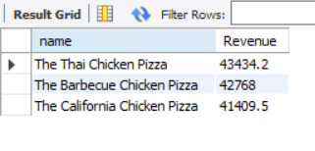
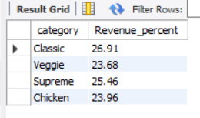
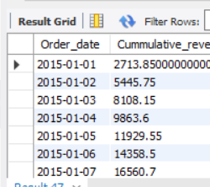
Determine the top 3 most ordered pizza types based on revenue.
select pizza_types.name,round(sum(pizzas.price*order_details.quantity),1) as Revenue
from pizza_types join pizzas on pizza_types.pizza_type_id = pizzas.pizza_type_id join
order_details on pizzas.pizza_id = order_details.pizza_id group by pizza_types.name
order by revenue desc limit 3;
Calculate the percentage contribution of each pizza category to total revenue.
Select category, round(Revenue/Overall_revenue * 100,2) as Revenue_percent from
(select pizza_types.category,round(sum(pizzas.price * order_details.quantity),2)
as Revenue,(select sum(pizzas.price * order_details.quantity) from pizzas
join order_details on pizzas.pizza_id = order_details.pizza_id) as Overall_revenue
from pizza_types join pizzas on pizza_types.pizza_type_id = pizzas.pizza_type_id
join order_details on pizzas.pizza_id = order_details.pizza_id group by category) as datatable ;
Analyze the cumulative revenue generated over time.
Select Order_date,sum(revenue) over (order by Order_date) as Cummulative_revenue from (Select orders.Order_date,sum(pizzas.price * order_details.quantity) as Revenue from pizzas join order_details on pizzas.pizza_id = order_details.pizza_id join orders on orders.Order_id = order_details.Order_id group by orders.Order_date) as Data;

Slide 7
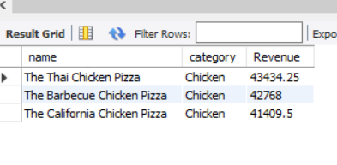
Determine the top 3 most ordered pizza types based on revenue for each pizza category.
Select pizza_types.name,pizza_types.category,round(sum(pizzas.price * order_details.quantity),2)
as Revenue from pizzas join pizza_types on pizzas.pizza_type_id = pizza_types.pizza_type_id join
order_details on pizzas.pizza_id = order_details.pizza_id group by name,category order by revenue desc limit 3;

